Slide 1
Ensemble Learning
Anshu Pandey

Slide 2
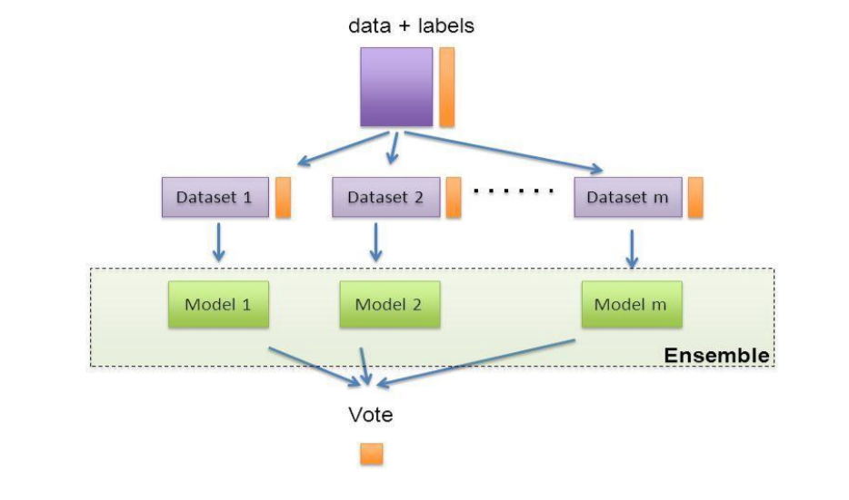
Ensemble Learning
Ensemble learning is technique that creates multiple models and then combines them to produce improved results

Slide 3
Types of Ensemble Models
Ensemble Learning
Bagging
Boosting
Stacking

Slide 4
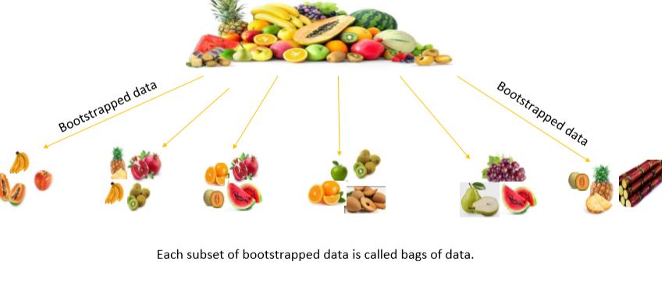
Bagging
Bagging also called Bootstrapped aggregation.
Bootstrap in statistics denotes sampling with replacement.

Slide 5
Random Forest
Random Forest algorithm is example of bagging technique.
Random forest is collection of many decision trees

Slide 6
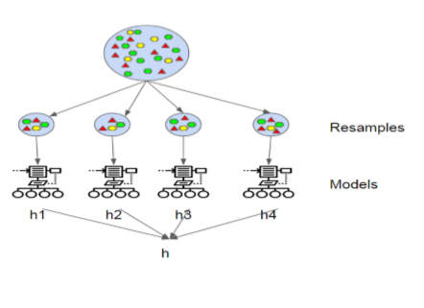
Random Forest
Random forest (or random forests) is an ensemble classifier that consists of many decision trees and outputs the class that is the mode of the class's output by individual trees.

Slide 7
Why Random Forest is called Random?
There are two types of randomness in RF algorithm—
Row level
Column level

Slide 8
Working of Random Forest
Assume number of cases in the training set is N. Then, sample of these N cases is taken at random but with replacement. This sample will be the training set for growing the tree.
If there are M input variables, a number m<M is specified such that at each node, m variables are selected at random out of the M. The best split on these m is used to split the node. The value of m is held constant while we grow the forest.
Each tree is grown to the largest extent possible and there is no pruning.
Predict new data by aggregating the predictions of the ntree trees (i.e., majority votes for classification, average for regression).

Slide 9
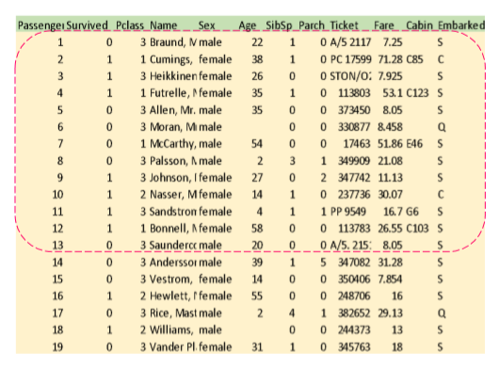
Validation of Random Forest with Out of Bag data
Some data points don’t go into the bag for training.
Those data are called Out of Bag data/sample.
If this is the entire training data, then only 2/3 of the data is used for model building in Random Forest.
This 2/3 of the data goes into the bag.

Slide 10
OOB Error
The prediction accuracy on out of bag(OOB) data is called Out of Bag score. 1- Out of Bag score= Out of Bag error
Smaller the OOB error better the model.

Slide 11

Features and Advantages of Random Forest
Random Forest is one of the most powerful Machine Learning algorithms.
Accuracy
Handling large scale data
Handling high dimensional data
It provides excellent accuracy both for classification & regression.
Efficiently handles large scale data making it scalable based on increasing data size
Takes only important features without deleting unwanted ones.

Slide 12
Hyperparameters of Random Forest
Inherited from Decision Tree
criterion : string, optional (default=”gini”) | The function to measure the quality of a split. Supported criteria are “gini” for the Gini impurity and “entropy” for the information gain.
max_depth : int or None, optional (default=None) | The maximum depth of the tree. If None, then nodes are expanded until all leaves are pure or until all leaves contain less than min_samples_split samples.
min_samples_split : int, float, optional (default=2) | The minimum number of samples required to split an internal node
min_samples_leaf : int, float, optional (default=1) | The minimum number of samples required to be at a leaf node. A split point at any depth will only be considered if it leaves at least min_samples_leaf training samples in each of the left and right branches. This may have the effect of smoothing the model, especially in regression.
max_features : int, float, string or None, optional (default=None) | The number of features to consider when looking for the best split: If “auto”, then max_features=sqrt(n_features). If “sqrt”, then max_features=sqrt(n_features). If “log2”, then max_features=log2(n_features). If None, then max_features=n_features.
max_leaf_nodes : int or None, optional (default=None) | Grow a tree with max_leaf_nodes in best-first fashion. Best nodes are defined as relative reduction in impurity. If None then unlimited number of leaf nodes.
min_impurity_decrease : float, optional (default=0.) | A node will be split if this split induces a decrease of the impurity greater than or equal to this value.
class_weight : dict, list of dicts, “balanced”, default=None | Weights associated with classes in the form {class_label: weight}. If not given, all classes are supposed to have weight one.

Slide 13
Hyperparameters of Random Forest
Random Forest
n_estimators | integer, optional (default=10) The number of trees in the forest.
oob_score | bool (default=False),if true, it returns OOB score

Slide 14
Case Study

Slide 15
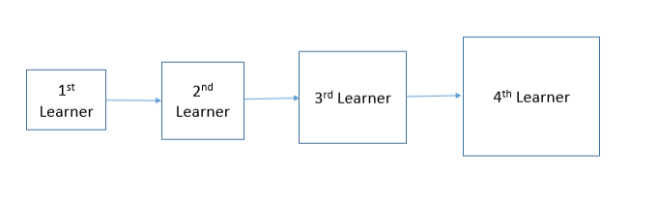
Boosting
Boosting is a form of ensemble learning in which weak learners get stronger through learning process.
Unlike bagging, boosting is a sequential learning process.

Slide 16
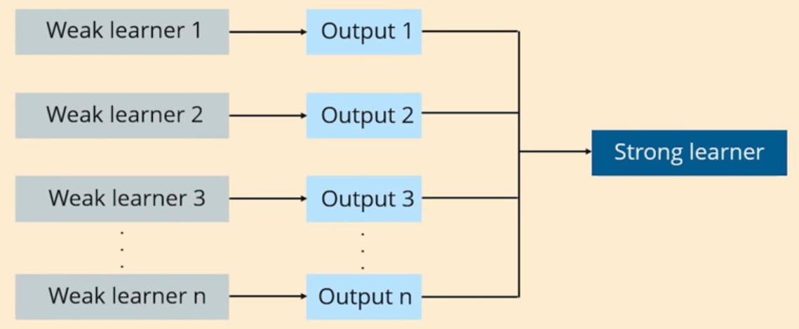
Boosting
Boosting involves ensemble learning in which decision trees try improve their prediction gradually and sequentially.
Boosting can be applied to both Regression and Classification.

Slide 17
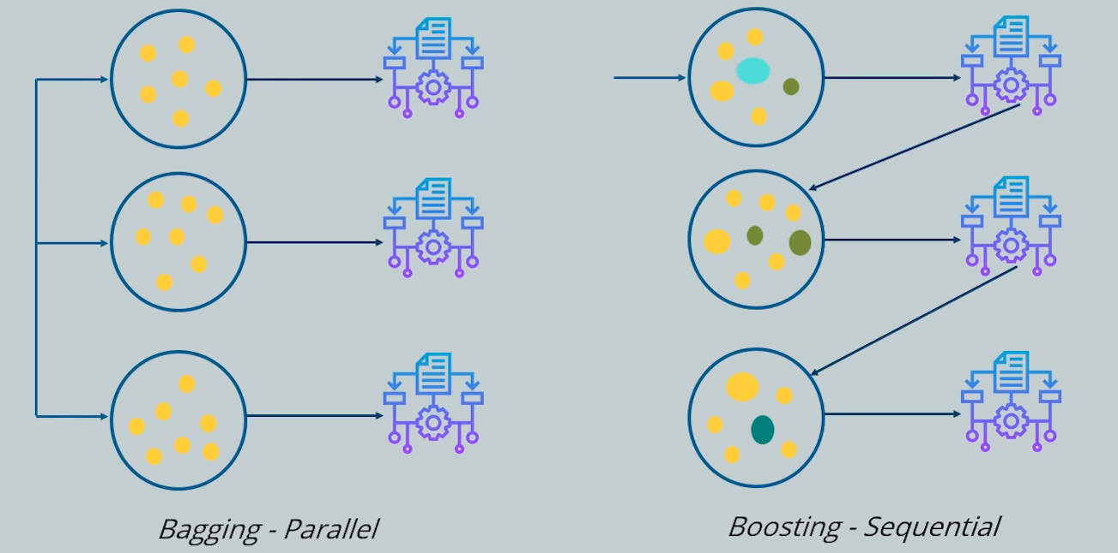
Bagging v/s Boosting

Slide 18
Types of Boosting methods
AdaBoost
Gradient Boosting
XGBoost

Slide 19
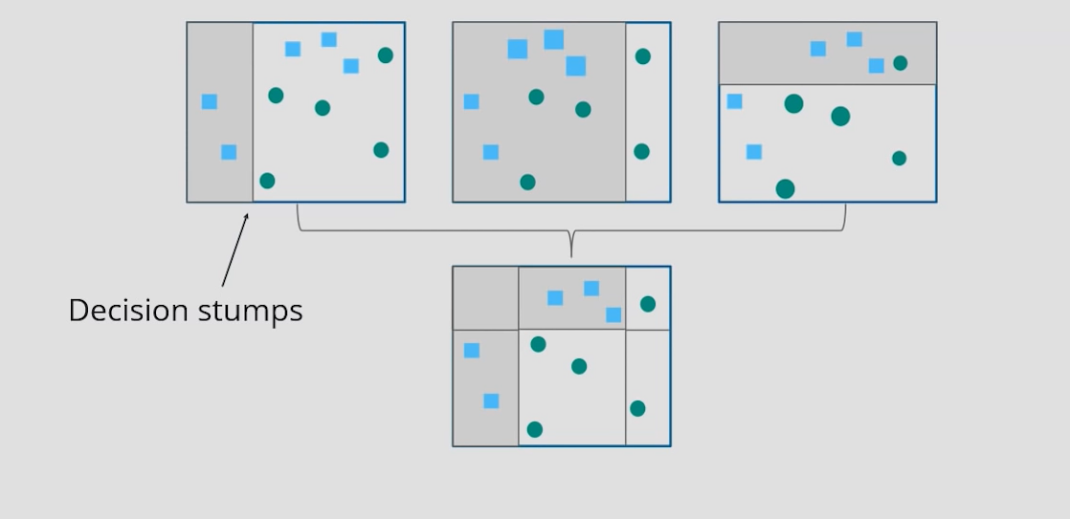
How does Adaptive boosting work?
This boosting technique involves four decision trees.
First tree draws D1 decision boundary and end up in many misclassification.
2nd tree learns slightly better and thus subsequent trees learn better than their ancestors.
Finally we get a tree , from which we get minimum loss(error).

Slide 20
Gradient Boosting Trees
Gradient boosting is a boosting process in which a number of decision trees are built sequentially.
It uses the concept of learning rate and reducing loss of Gradient descent.
Each decision tree learns from the mistake of its predecessors.
Each tree built tries to approximate the actual value through learning process.

Slide 21
XGBoost
XGBoost also called Extreme Gradient Boosting,
Uses the framework of Gradient Boosting Machine(GBM).
XGBoost is an optimized distributed gradient boosting library designed to be highly efficient, flexible and portable.
XGBoost provides a parallel tree boosting (also known as GBDT, GBM) that solve many data science problems in a fast and accurate way.

Slide 22
XGBoost
Parameters Description
learning_rate | How quickly error will reduce in gradient descent. Usually between 0.1 and 0.01
n_estimators | The number of trees or rounds in a Xgboost model
max_depth | Represents depth of each tree, Used to control overfitting
min_child_weight | Minimum sum of weights of all observations required in a child Used to control overfitting, too high value will lead to underfitting
max_leaf_nodes | The maximum number of terminal nodes or leaves in a tree. If this is defined, XGB will ignore max_depth
gamma | A node is split only when the resulting split gives a positive reduction in loss. Gamma specifies the minimum reduction in loss.
subsample | Denotes the fraction of obervations to be randomly sampled for each tree

Slide 23
Stacking
Stacking is an ensemble technique which
Trains several base learners.
Combines these models with a meta model, which likely provides better accuracy than individual base learners

Slide 24
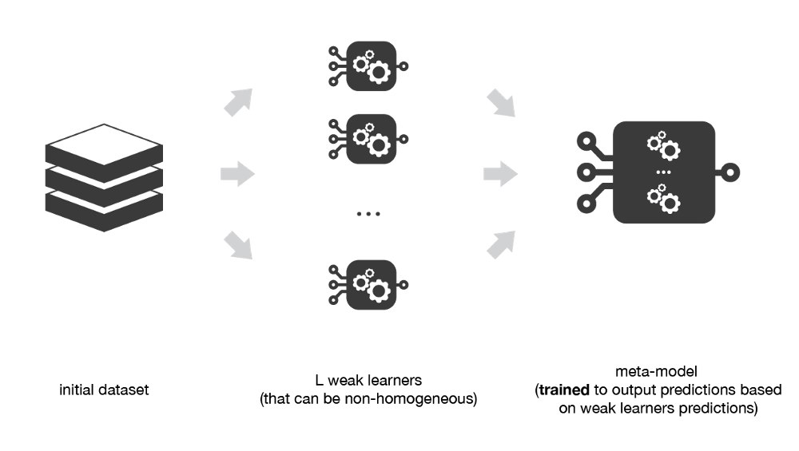
How Stacking Works?
Stacking considers several heterogeneous learners and combines them by training a meta model to output prediction based on the weak learners predictions.

Slide 25
How Stacking works?
These are the steps for building a Stacked model:
Split the training data into two folds (train and validation)
Choose N weak learners and fit them to the train data.
For each of the N weak learners make predictions for the observations in the validation data.
Fit the meta model on the validation data based on the predictions made by the weak learners as input.

Slide 26
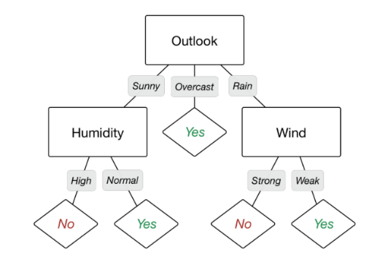
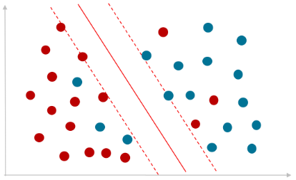
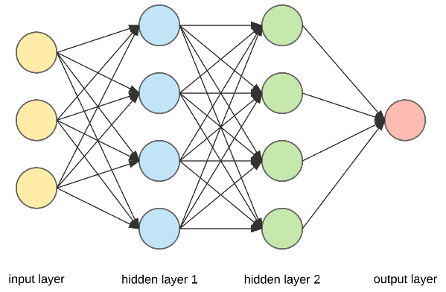
Generalized Stacking Architecture
Fail
Pass
Pass
Pass
Pass
Fail
Pass
Pass
Pass
The output of previous base model goes as the input of next model.
Instead of fitting the output, we can also fit the weighted output or probability score instead of class(pass/fail)
We do in n times if there are n models in the ensemble.

Slide 27
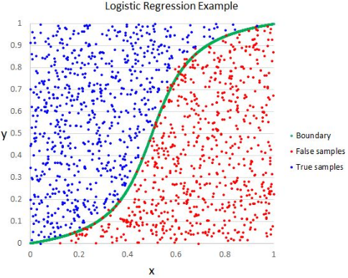
Specialized Stacking Architecture
The output of all base models
Actual Labels
Logistic Regression
Using the predictions from base learner as input and the labels as output, train the meta model.
The meta model is generally simpler than the base model.
In practice the flow in different layers should be from high complicated models to simple linear models

Slide 28
Stacking through mlxtend
from mlxtend.classifier import StackingClassifier
from sklearn.linear_model import LogisticRegression
from sklearn.ensemble import RandomForestClassifier
from sklearn.ensemble import GradientBoostingClassifier
rf_cl = RandomForestClassifier(10, random_state=seed)
gdb_cl = GradientBoostingClassifier(random_state=seed)
logreg = LogisticRegression()
sclf = StackingClassifier(classifiers=[rf_cl,gdb_cl],
meta_classifier=logreg)

Slide 30
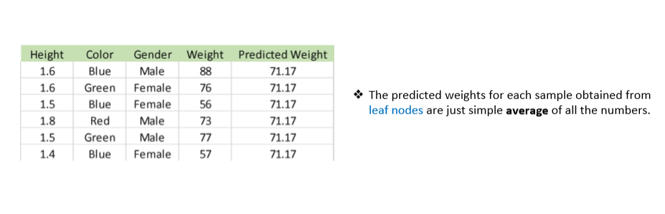
Gradient Boosting Explained

Slide 31
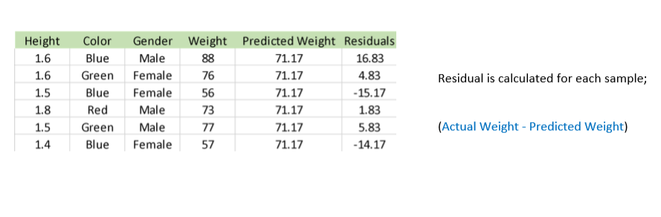
Gradient Boosting Explained

Slide 32
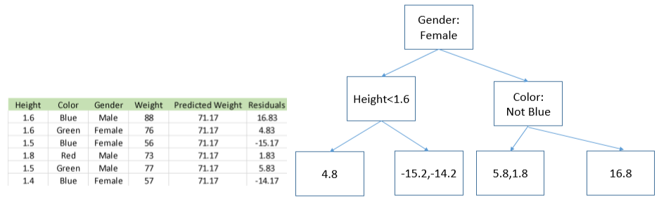
Gradient Boosting Explained

Slide 33
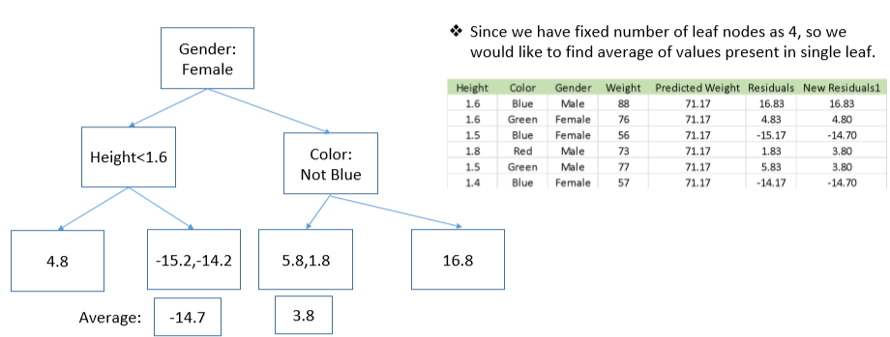
Gradient Boosting Explained

Slide 34
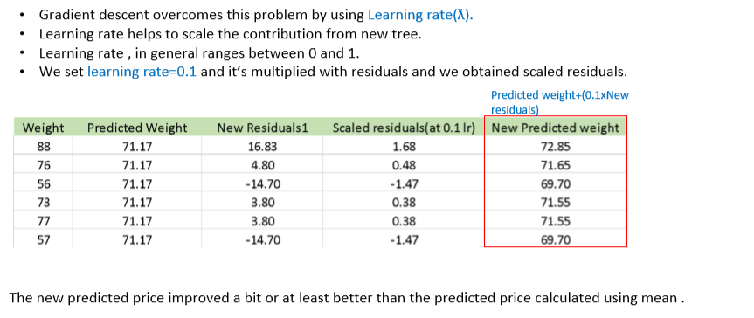
Gradient Boosting Explained

Slide 35
Gradient Boosting Explained

